Slide 1
FEES PAYMENT SYSTEM

Slide 2
Introduction to School Payment System
A school payment system is a comprehensive platform designed to streamline and automate the process of fee collection and management in educational institutions. This system replaces traditional manual methods, reducing paperwork and increasing efficiency. Key features include:
Fee Collection: Allows for easy addition, viewing, and updating of fee records.
Payment Tracking: Monitors payments made by students, displaying total fees collected and outstanding amounts.
Receipt Generation: Automatically generates receipts for fee payments, ensuring transparency.
Student Management: Maintains detailed records of students, including fee status and payment history.
Reporting: Provides detailed reports on fee collections, due payments, and overall financial status.

Slide 3
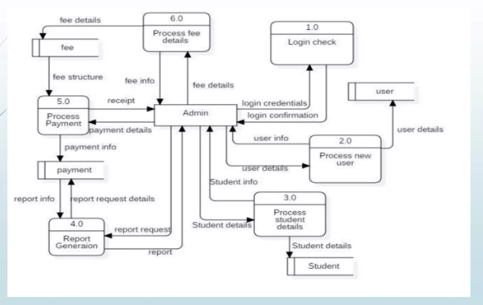

Slide 4
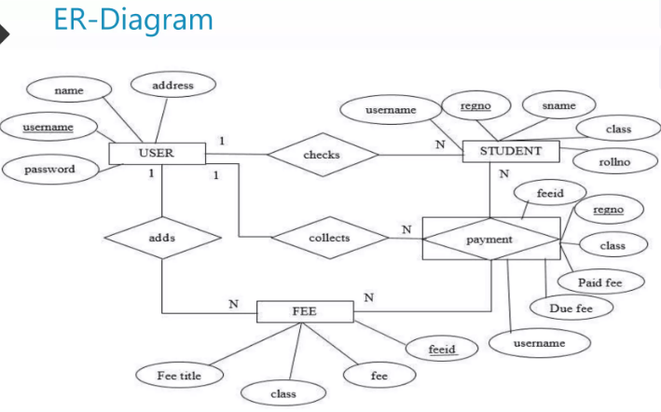

Slide 5
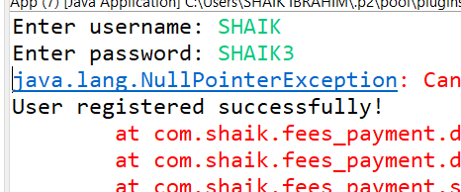

Slide 6
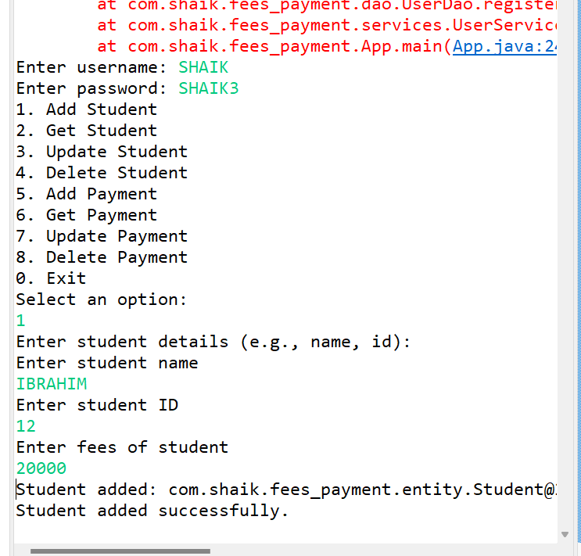

Slide 7
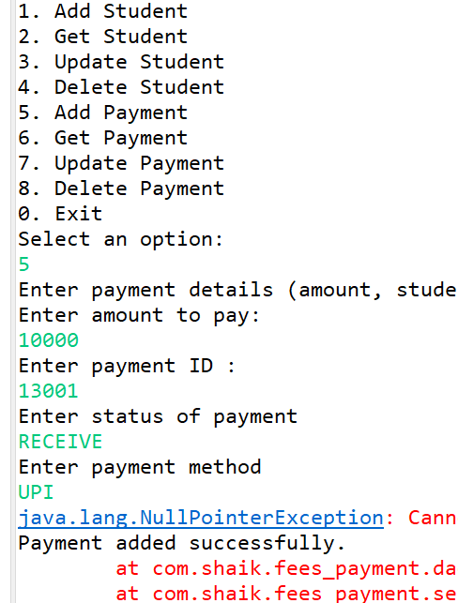

Slide 8
CONCLUSION
Implementing a school payment system brings numerous advantages to educational institutions. It simplifies the fee collection process, enhances transparency, and provides real-time insights into financial transactions. By automating administrative tasks, schools can save time and reduce errors, allowing staff to focus more on educational excellence and less on paperwork. Ultimately, a school payment system creates a more efficient, organized, and user-friendly environment for students, parents, and school administrators alike.

Slide 9


